Slide 1

EDA of IPL Matches(2008-2018) MADE BY: -AMBER JAIN

Slide 2
PROBLEM STATEMENT
The data set is from IPL(Indian Premier League) of 11 years(2008 – 2018)
Need to research on performance of every team in 11 years and finding best player for each franchise.

Slide 3
Data Loading and Description
The dataset consist of the information about all the matches played between each teams in 11 editions of IPL(2008-2018). Various variables are present in the dataset includes season, matches between team(team1 and team2), toss winner, decision(batting, bowling), match results, player of the match, venue(where match is played), umpire 1 , umpire2, umpire3 etc.
The dataset comprises of 696 observations and 18 columns.
IPL stands for Indian Premier League which has been started 2008 after India winning the T-20 Cricket World Cup. It is 20 over cricket format which is more entertaining and more popular day by day. It is most famous league of cricket across all cricket playing nations. Every team have some Indian Players (International and Uncapped) and some overseas players. Every team play each other like robin round(1 home and 1 away match). It is most popular league.

Slide 4
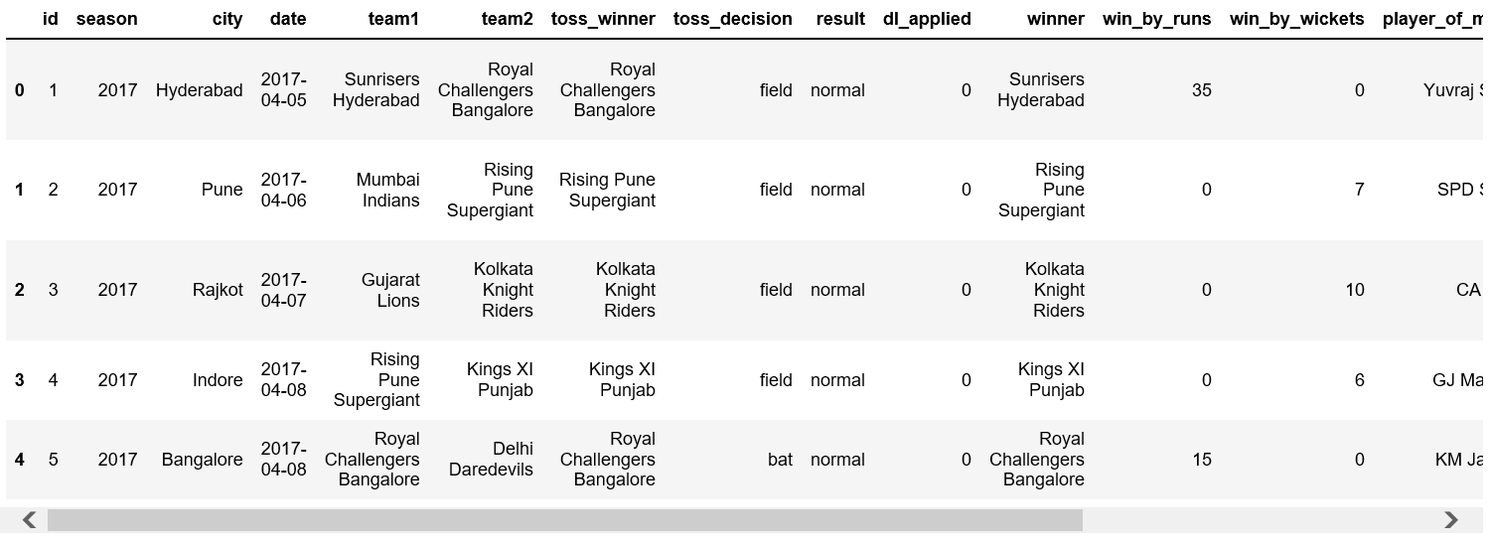
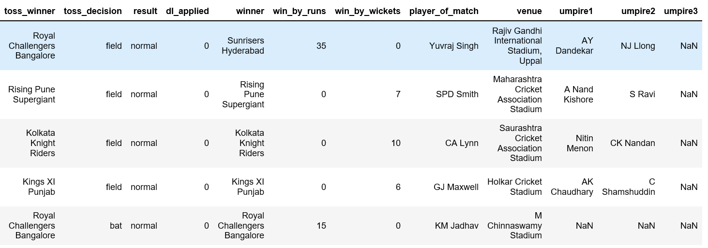
Data in Dataset

Slide 5
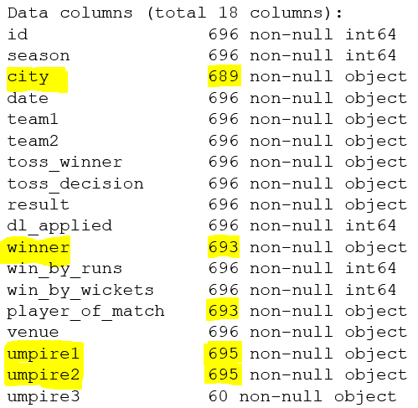
Pre Processing Data
Actual Data
Missing Values
City column have 7 missing values
Winner has 3 missing values
Player of match have 3 missing values
Umpire1 and Umpire2 have 1 missing value
Umpire 3 has around 90% missing values.

Slide 6
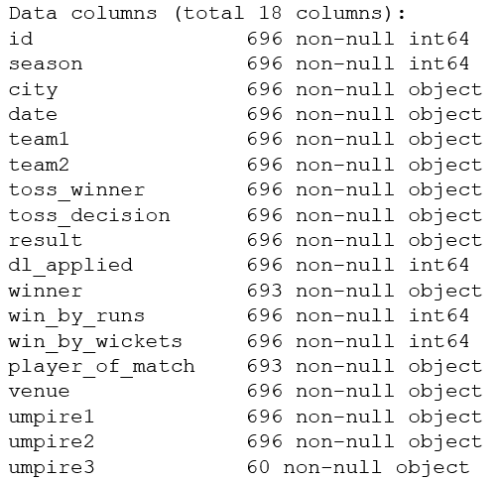
Analysis and Replaced Missing Values
City: - Replaced missing values of 7 city with “Dubai” as venue of that match was “Dubai International Cricket Stadium”.
Winner: - Checked there are 3 matches with no result, means match has been abandon due to heavy rain or bad flood lights.
Player of the Match: - Checked there are 3 matches where player of match is null, but this 3 matches have no result so we keep that as it is.
Umpire1: - Replaced 1 missing value with mode of Umpire 1.
Umpire2: - Replaced 1 missing value with mode of Umpire 2.

Slide 7
Some More Analysis on Data
7 number of matches end in tie and winner has been declared by super over(1 over match).
3 matches has been abandon due to heavy rains or bad flood lights.
19 number of IPL matches where winner decision is taken by DL method.
14 different teams has been participated in 11 IPL editions. 10 teams participated in IPL 2011, 9 teams participated in IPL 2012 & 2013 edition and in remaining IPL 8 teams participated.
Chris Gayle is the best player of 11 IPL editions as he won the maximum number of “player of match” award(20 times).

Slide 8
Some Interesting Data’s
60% matches team won the toss and elected to field, while 40% matches team won the toss and elected to bat implies team loves chasing the target.
51% matches won by the team who wins the toss.
55% matches won by the team who won the toss and elected to field, while only 31% matches won by the team who won the toss and elected to bat.

Slide 9
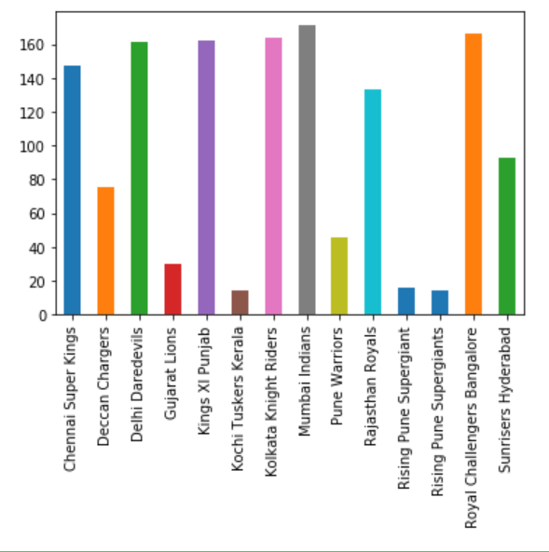
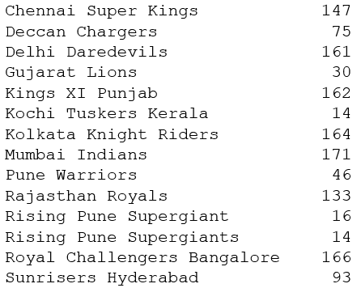
Which team played maximum number of matches in IPL(2008-18)? Mumbai Indians

Slide 10
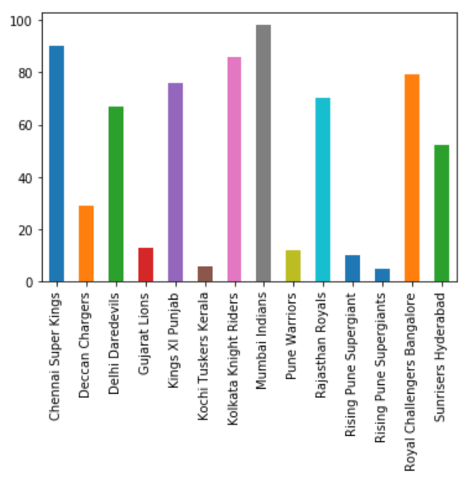
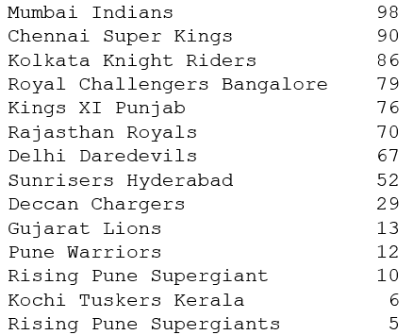
Which team won maximum number of matches in IPL(2008-18)? Mumbai Indians

Slide 11
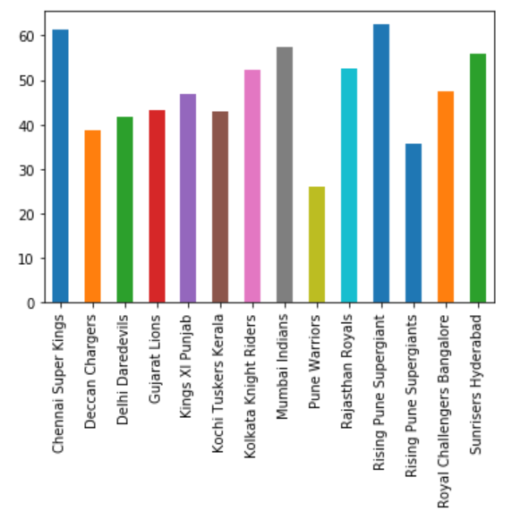
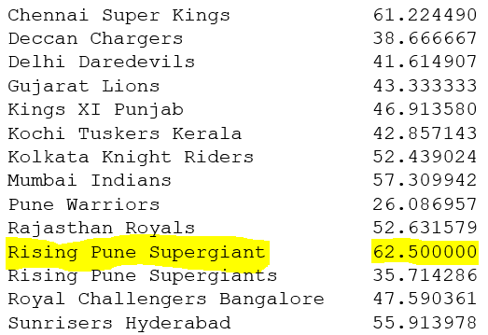
Which team won maximum percentage of matches in IPL(2008-18)? Rising Pune Supergiant

Slide 12
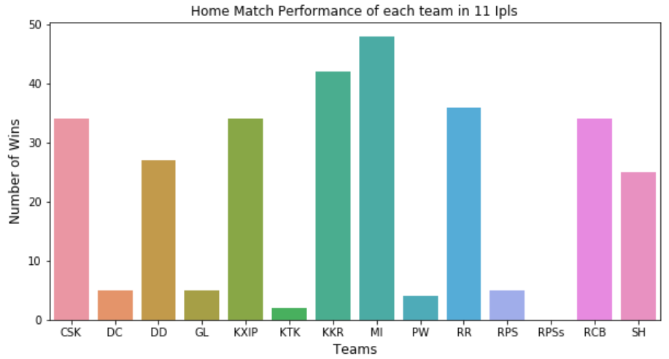
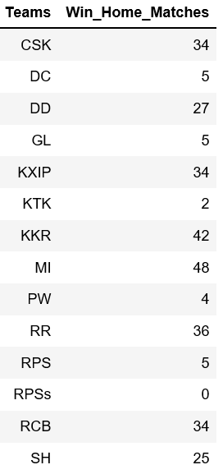
Which team won maximum number of home matches in IPL(2008-18)? Mumbai Indians

Slide 13
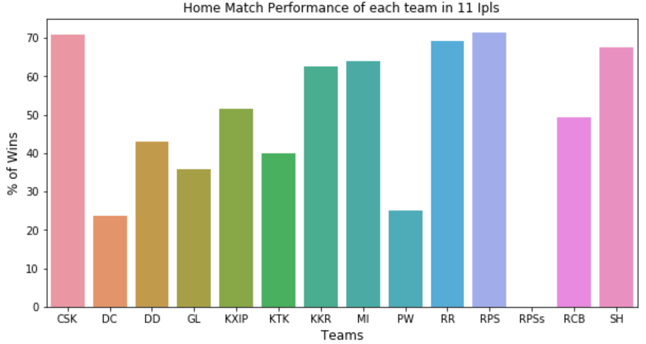
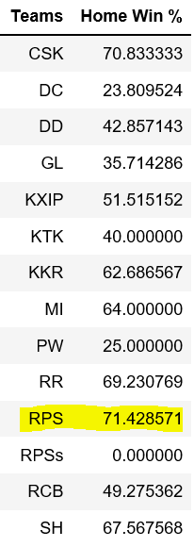
Which team won maximum percentage of home matches in IPL(2008-18)? Rising Pune Supergiant

Slide 14
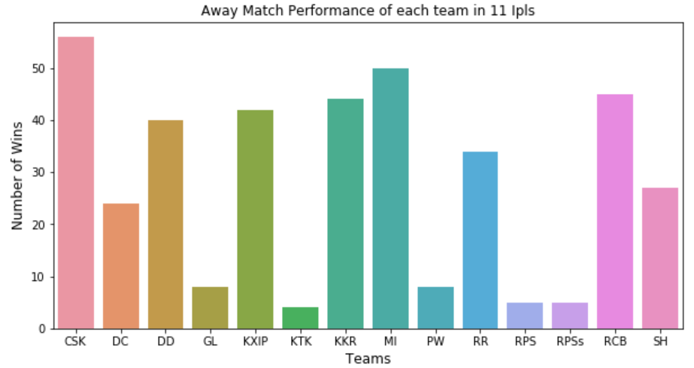
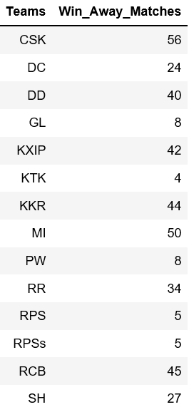
Which team won maximum number of away matches in IPL(2008-18)? Chennai Super Kings

Slide 15
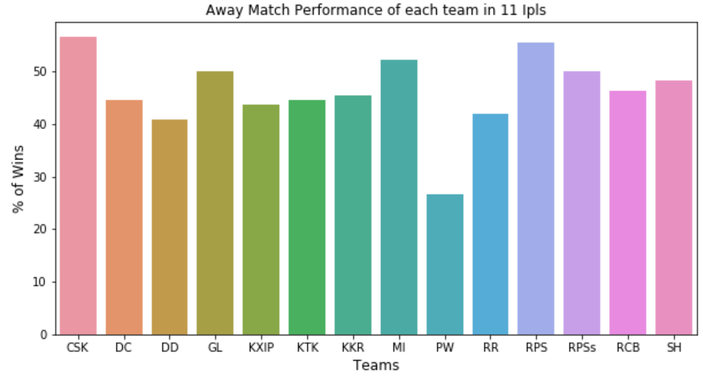
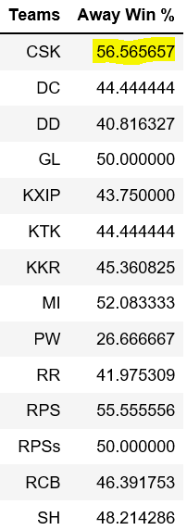
Which team won maximum percentage of away matches in IPL(2008-18)? Chennai Super Kings

Slide 16
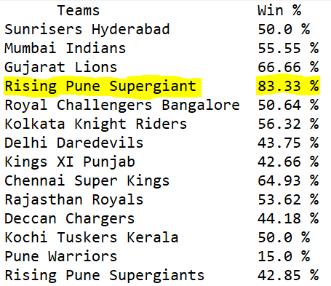
Which team won maximum percentage of matches in IPL(2008-18) if they won the toss? Rising Pune Supergiant

Slide 17
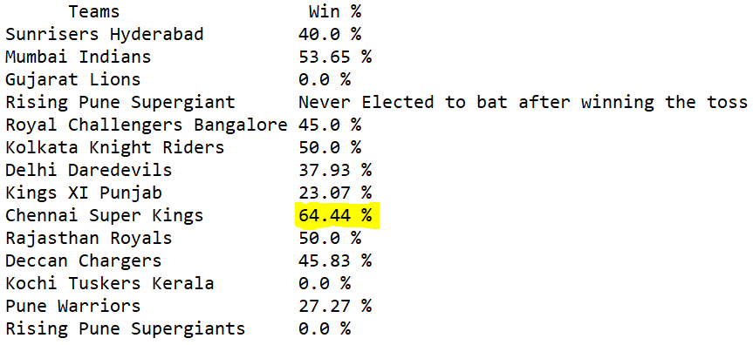
Which team won maximum percentage of matches won in IPL(2008-18) if they won the toss and elected to bat as well? Chennai Super Kings

Slide 18
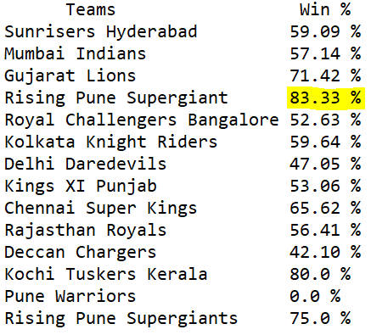
Which team won maximum percentage of matches won in IPL(2008-18) if they won the toss and elected to field as well? Rising Pune Supergiant

Slide 19
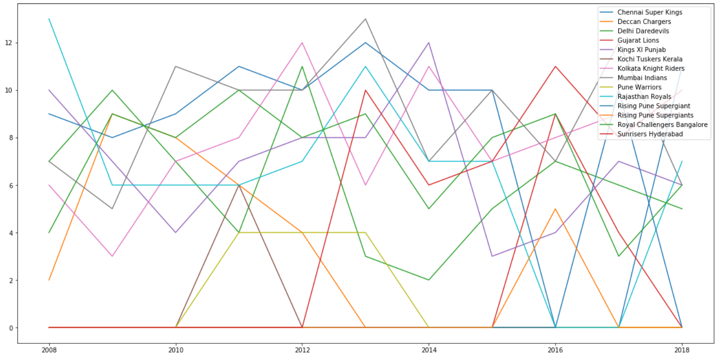
Performance of each time in every IPL edition(2008-18)?

Slide 20
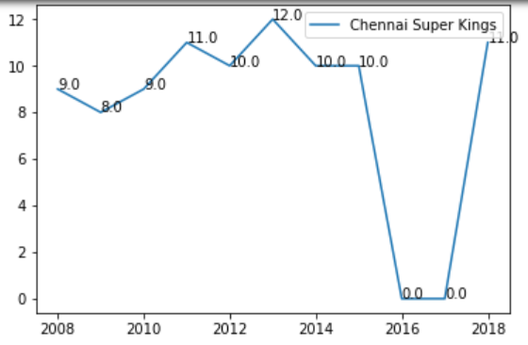
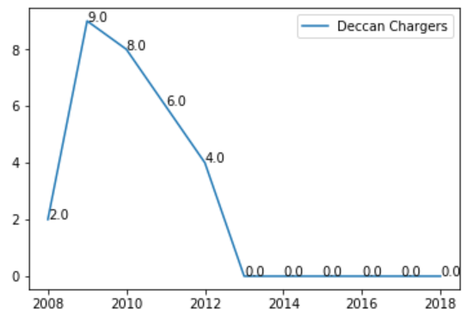
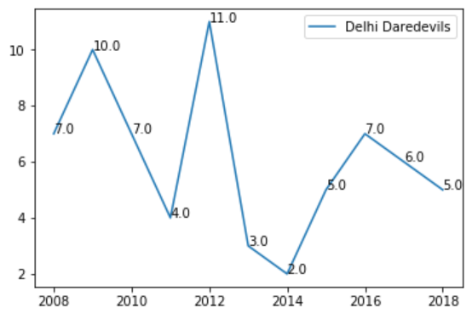
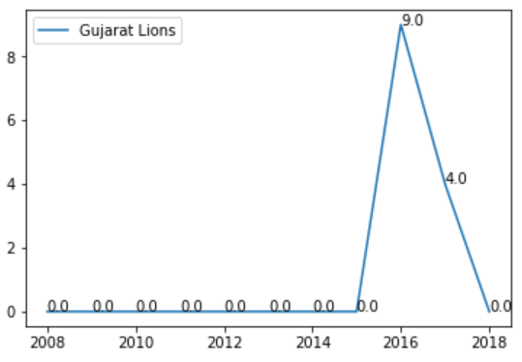

Slide 21
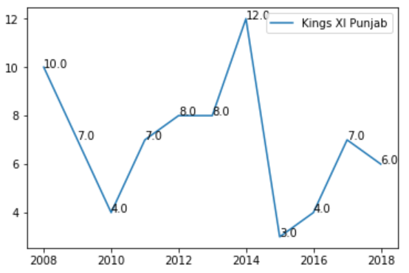
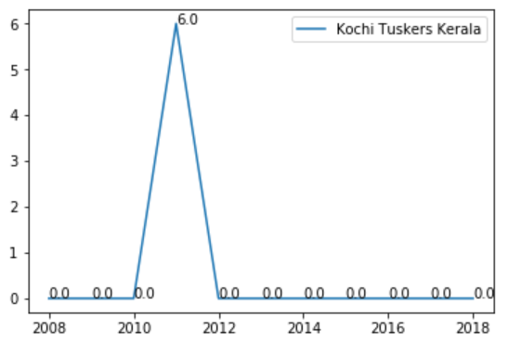
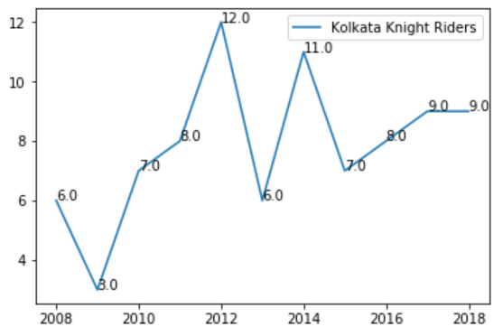
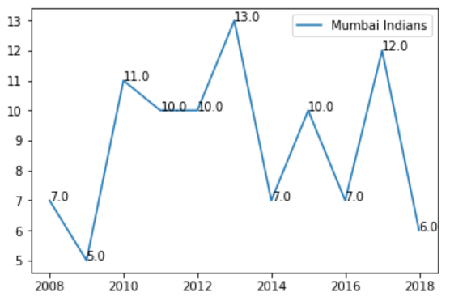

Slide 22
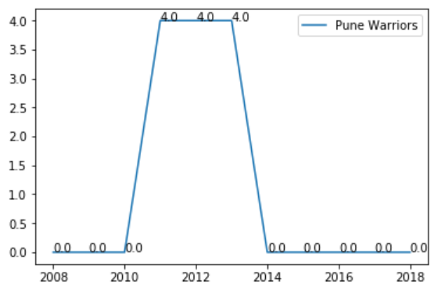
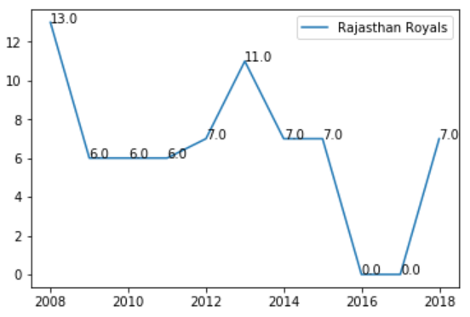
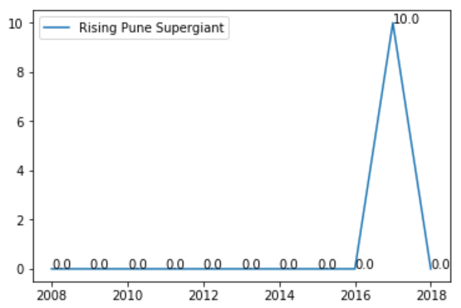
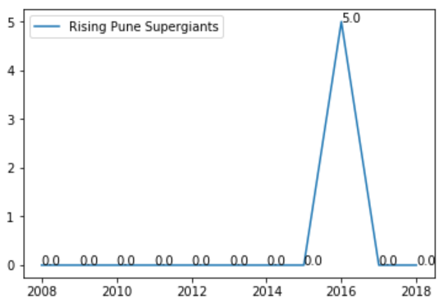

Slide 23
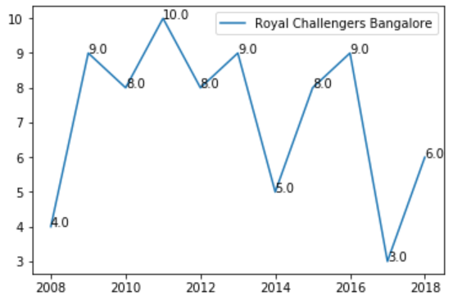
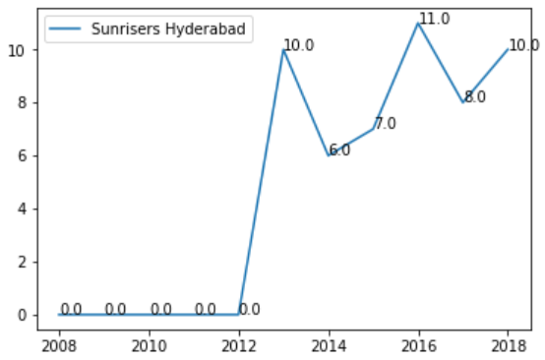

Slide 24
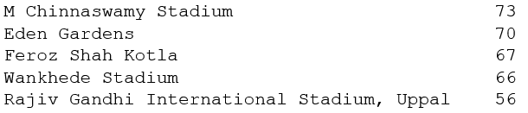
5 Stadiums who host maximum number of Matches

Slide 25
Best Player for each Team(Franchise)
Team Name
Player Name
Sunrisers Hyderabad
Mumbai Indians
Rising Pune Supergiant
Royal Challengers Bangalore
Kolkata Knight Riders
Delhi Daredevils
Kings XI Punjab
Rajasthan Royals
Deccan Chargers
Pune Warriors
Gujarat Lions
Chennai Super Kings
Kochi Tuskers Kerala
Rising Pune Supergiants
DA Warner
RG Sharma
BA Stokes
CH Gayle
G Gambhir
V Sehwag
SE Marsh
AM Rahane
AC Gilchrist
SPD Smith
DR Smith & AJ Finch
SK Raina & MS Dhoni
BJ Hodge & BB McCullum
AM Rahane & AB Dinda

Slide 26

THANK YOU

